Slide 1
Pipeline Hazards
Morteza Nikooghadam
Chapter 10

Slide 2
Review
Pipelined CPU
  Overlapped execution of multiple instructions
  Each on a different stage using a different major functional unit in datapath
    IF, ID, EX, MEM, WB
    Same number of stages for all instruction types
  Improved overall throughput
    Effective CPI=1 (ideal case)
Pipeline Hazards

Slide 3
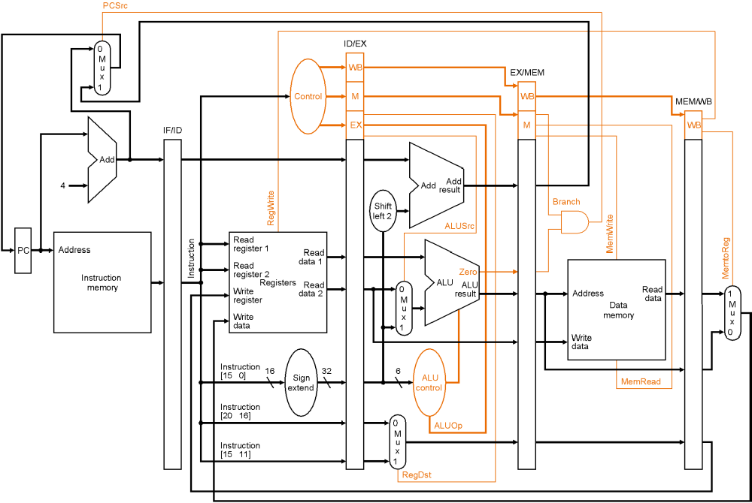
Recap: Pipelined Datapath
Pipeline Hazards

Slide 4
Recap: Pipeline Hazards
Hazards prevent next instruction from executing during its designated clock cycle
  Structural hazards: attempt to use the same resource two different ways at the same time
    One memory
  Data hazards: attempt to use data before it is ready
    Instruction depends on result of prior instruction still in the pipeline
  Control hazards: attempt to make a decision before condition is evaluated
    Branch instructions
Pipeline implementation need to detect and resolve hazards
Pipeline Hazards

Slide 5
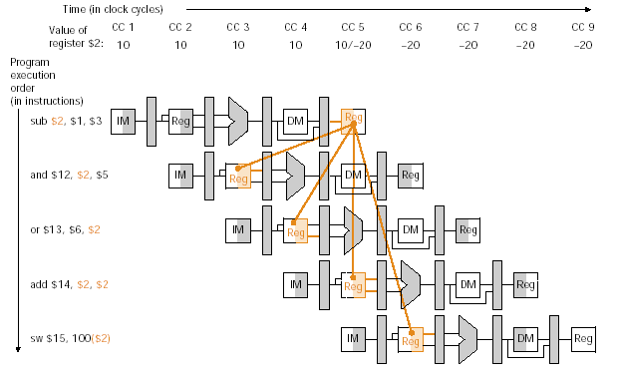
Data Hazards
An example: what if initially $2=10, $1=10, $3=30?
Fig. 6.28
Pipeline Hazards

Slide 6
Resolving Data Hazard
Register file design: allow a register to be read and written in the same clock cycle:
  Always write a register in the first half of CC and read it in the second half of that CC
  Resolve the hazard between sub and add in previous example
Insert NOP instructions, or independent instructions by compiler
  NOP: pipeline bubble
Detect the hazard, then forward the proper value
  The good way
Pipeline Hazards

Slide 7
Forwarding
From the example,
sub $2, $1, $3 IF ID EX MEM WB
and $12, $2, $5 IF ID EX MEM WB
or $13, $6, $2 IF ID EX MEM WB
  And and or needs the value of $2 at EX stage
  Valid value of $2 generated by sub at EX stage
  We can execute and and or without stalls if the result can be forwarded to them directly
Forwarding
  Need to detect the hazards and determine when/to which instruciton data need to be passed
Pipeline Hazards

Slide 8
Data Hazard Detection
From the example,
sub $2, $1, $3 IF ID EX MEM WB
and $12, $2, $5 IF ID EX MEM WB
or $13, $6, $2 IF ID EX MEM WB
  And and or needs the value of $2 at EX stage
  For first two instructions, need to detect hazard before and enters EX stage (while sub about to enter MEM)
  For the 1st and 3rd instructions, need to detect hazard before or enters EX (while sub about to enter WB)
Hazard detection conditions: EX hazard and MEM hazard
  1a. EX/MEM.RegisterRd = ID/EX.RegisterRs
  1b. EX/MEM.RegisterRd = ID/EX.RegisterRt
  2a. MEM/WB.RegisterRd = ID/EX.RegisterRs
  2b. MEM/WB.RegisterRd = ID/EX.RegisterRt
Pipeline Hazards

Slide 9
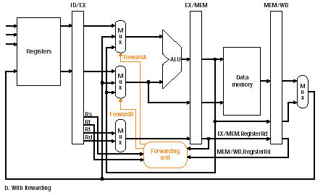
Add Forwarding Paths
Pipeline Hazards

Slide 10
Refine Hazard Detection Condition
Conditions 1 and 2 are true, but instruction occurs earlier does not write registers
  No hazard
  Check RegWrite signal in the WB field of the EX/MEM and MEM/WB pipeline register
Condition 1 and 2 are true, but RegisterRd is $0
  Register $0 should always keep zero and any non-zero result should not be forwarded
  No hazard
Pipeline Hazards

Slide 11
New Hazard Detection Conditions
EX hazard
if ( EX/MEM.RegWrite
and (EX/MEM.RegisterRd != 0)
and (EX/MEM.RegisterRd = ID/EX.RegisterRs))
ForwardA = 10
if ( EX/MEM.RegWrite
and (EX/MEM.RegisterRd != 0)
and (EX/MEM.RegisterRd = ID/EX.RegisterRt))
ForwardB = 10
One instruction ahead
Pipeline Hazards

Slide 12
New Hazard Detection Conditions
MEM Hazard
if ( MEM/WB.RegWrite
and (MEM/WB.RegisterRd !=0)
and (MEM/WB.RegisterRd = ID/EX.RegisterRs))
ForwardA = 01
if ( MEM/WB.RegWrite
and (MEM/WB.RegisterRd !=0)
and (MEM/WB.RegisterRd = ID/EX.RegisterRt))
ForwardB = 01
Two instructions ahead
Pipeline Hazards

Slide 13
New Complication
For code sequence:
add $1, $1, $2,
add $1, $1, $3,
add $1, $1, $4
  The third instruction depends on the second, not the first
  Should forward the ALU result from the second instruction
  For MEM hazard, need to check additionally:
    EX/MEM.RegisterRd != ID/EX.RegisterRs
    EX/MEM.RegisterRd != ID/EX.RegisterRt
Pipeline Hazards

Slide 14
Refined Hazard Detection Conditions
MEM Hazard
if ( MEM/WB.RegWrite
and (MEM/WB.RegisterRd !=0)
and (EX/MEM.RegisterRd != ID/EX.RegisterRs)
and (MEM/WB.RegisterRd = ID/EX.RegisterRs))
ForwardA = 01
if ( MEM/WB.RegWrite
and (MEM/WB.RegisterRd !=0)
and (EX/MEM.RegisterRd != ID/EX.RegisterRt)
and (MEM/WB.RegisterRd = ID/EX.RegisterRt))
ForwardB = 01
Pipeline Hazards

Slide 15
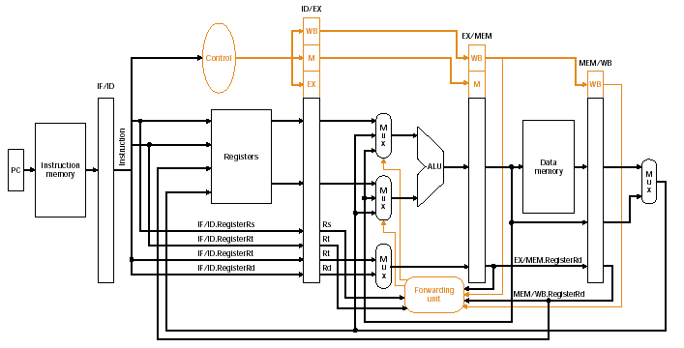
Datapath with Forwarding Path
Pipeline Hazards

Slide 16
Example
Show how forwarding works with the following instruction sequence
sub $2, $1, $3
and $4, $2, $5
or $4, $4, $2
add $9, $4, $2
Pipeline Hazards

Slide 17
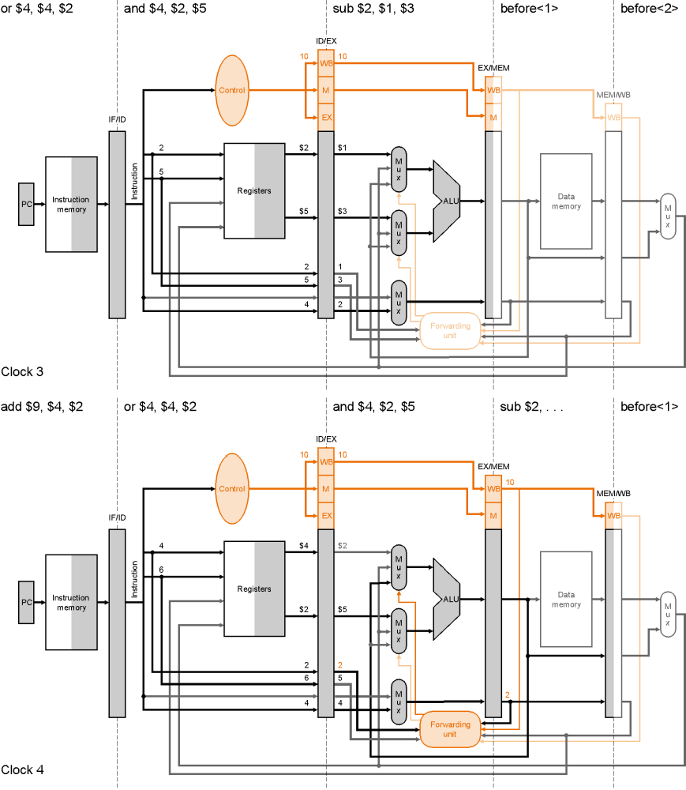
Clock 3
CS465
Pipeline Hazards

Slide 18
Clock 4
Pipeline Hazards

Slide 19
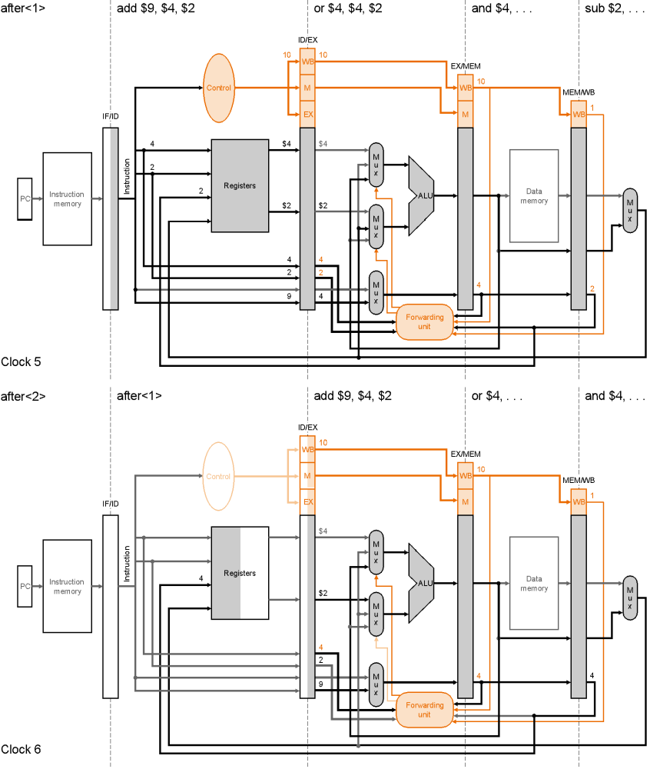
Clock 5
CS465
Pipeline Hazards

Slide 20
Clock 6
Pipeline Hazards

Slide 21
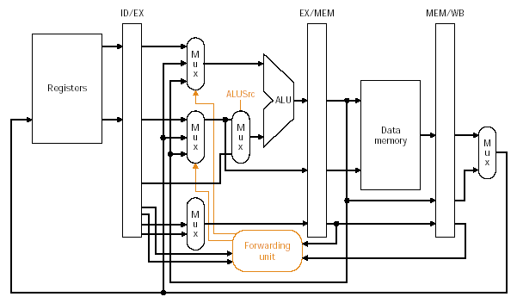
Adding ALUSrc Mux to Datapath
Sign-Extension(lw/sw)
Fig. 6.33
Pipeline Hazards

Slide 22
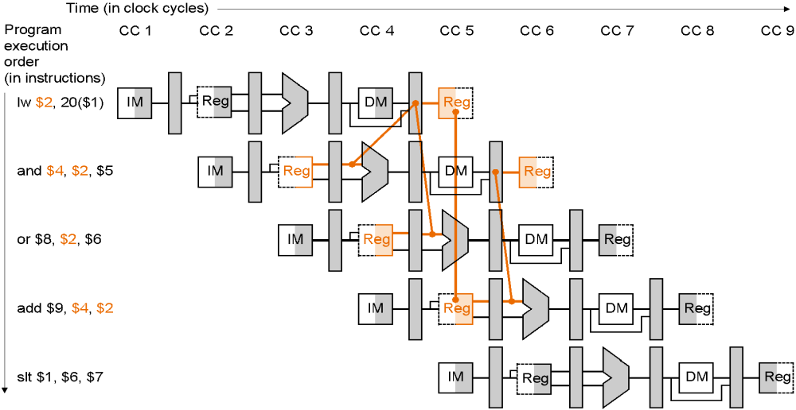
Forwarding Can’t do Anything!
When a load instruction that writes a register followed by an instruction reading the same register forwarding does not help
  Stall the pipeline
Pipeline Hazards

Slide 23
Hazard Detection
In order to insert the stall(bubble), we need an additional hazard detection unit
  Detect at ID stage, why?
  Detection logic
  if ( ID/EX.MemRead
  and ( (ID/EX.RegisterRt = IF/ID.RegisterRs)
  or (ID/EX.RegisterRt = IF/ID.RegisterRt) ))
  stall the pipeline
Stall the pipeline at ID stage
  Set all control signals to 0, inserting a bubble (NOP operation)
  Keep IF/ID unchanged – repeat the previous cycle
  Keep PC unchanged – refetch the same instruction
  Add PCWrite and IF/IDWrite control to data hazard detection logic
Pipeline Hazards
Notes:
What is the difference between the hazard detection unit and data forwarding unit?

Slide 24
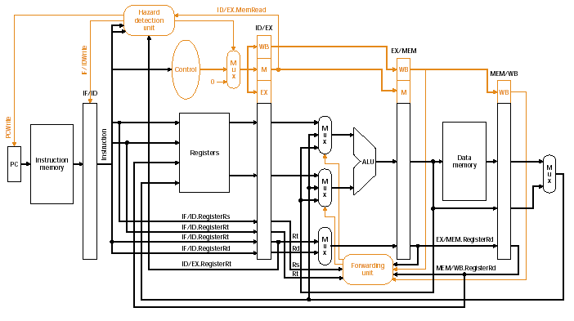
Pipelined Control
Fig. 6.36: Control w/ Hazard Detection and Data Forwarding Units
Pipeline Hazards

Slide 25
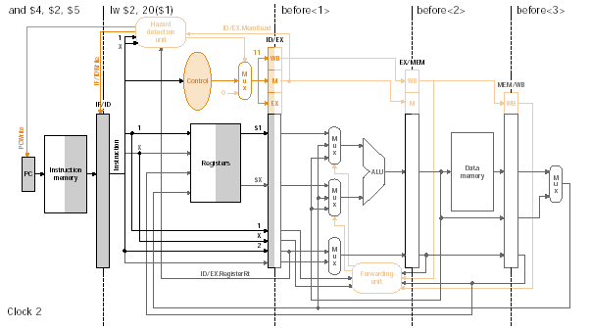
Example – Clock 2
Pipeline Hazards

Slide 26
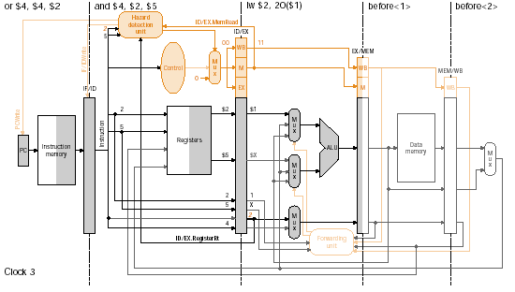
Clock 3
Pipeline Hazards

Slide 27
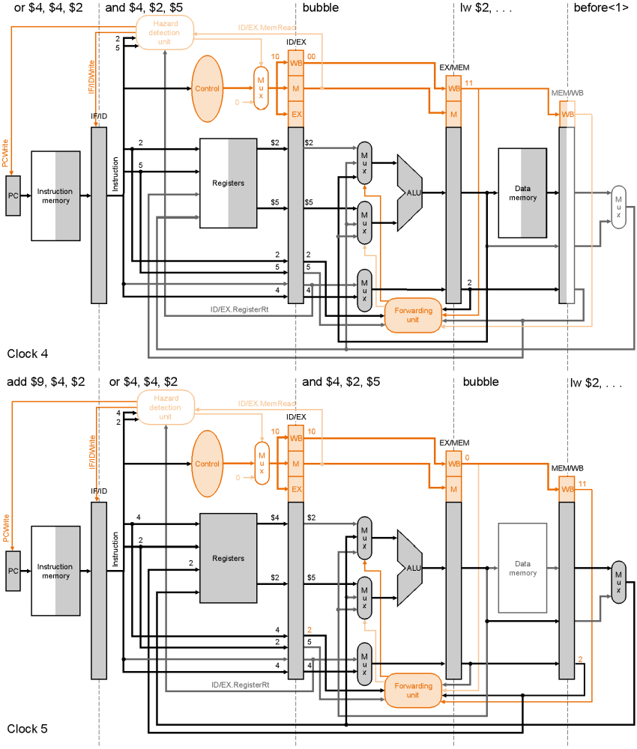
Clock 4
CS465
Pipeline Hazards

Slide 28
Clock 5
Pipeline Hazards

Slide 29
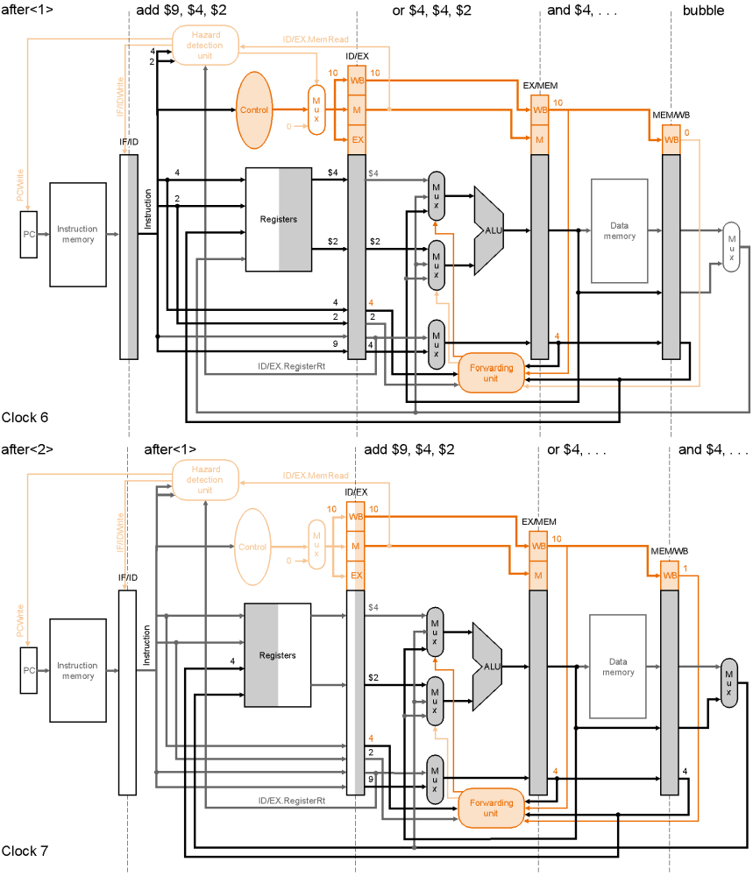
Clock 6
CS465
Pipeline Hazards

Slide 30
Clock 7
Pipeline Hazards

Slide 31
How about Store Word?
SW can cause data hazards too
  Does the forwarding help?
  Does the existing forwarding hardware help?
Easy case if SW depends on ALU operations
  What if a LW immediately followed by a SW?
Pipeline Hazards

Slide 32

LW and SW
Sign-Ext
lw $5, 0($15)
sw $5, 100($15)
lw $5, 0($15)
…
sw $4, 100($5)
lw $5, 0($15)
sw $8, 100($5)
Pipeline Hazards
Notes:
lw $5, 0($15)
beq $5, $0, Exit
sw $5, 100($15)

Slide 33
SW is in MEM Stage
sw
lw
Sign-Ext
lw $5, 0($15)
sw $5, 100($15)
MEM/WB.RegWrite and EX/MEM.MemWrite and
MEM/WB.RegisterRt = EX/MEM.RegisterRt and
MEM/WB.RegisterRt != 0
EX/MEM
Data
memory
Pipeline Hazards

Slide 34
SW is In EX Stage
sw
lw
Sign-Ext
ID/EX.MemWrite and MEM/WB.RegWrite and
MEM/WB.RegisterRt = ID/EX.RegisterRt(Rs) and
MEM/WB.RegisterRt != 0
Pipeline Hazards

Slide 35
Outline
Data hazards
  When does a data hazard happen?
    Data dependencies
  Using forwarding to overcome data hazards
    Data is available after ALU stage
    Forwarding conditions
  Stall the pipeline for load-use instructions
    Data is available after MEM stage (lw instruction)
    Hazard detection conditions
Next: control hazards
Pipeline Hazards

Slide 36
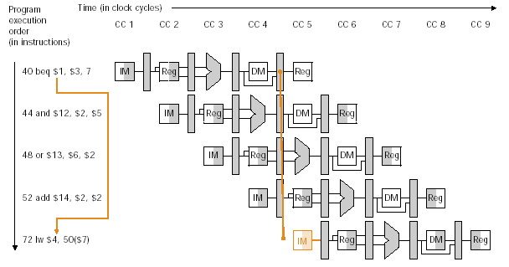
Branch Hazards
Control hazard: branch has a delay in determining the proper inst to fetch
Pipeline Hazards

Slide 37
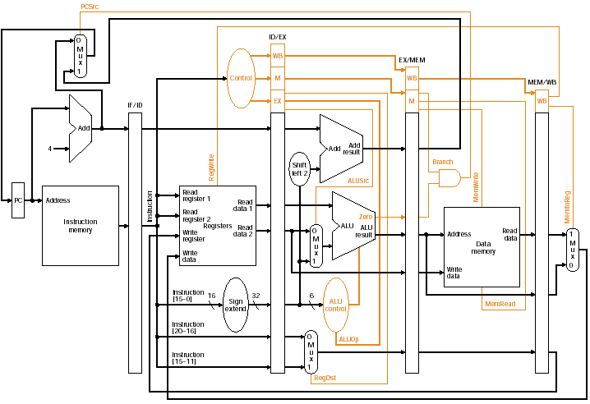
Branch Hazards
Decision is made here
flush
flush
flush
Pipeline Hazards

Slide 38
Observations
Basic implementation
  Branch decision does not occur until MEM stage
  3 CCs are wasted
How to decide branch earlier and reduce delay
  In EX stage - two CCs branch delay
  In ID stage - one CC branch delay
  How?
    For beq $x, $y, label, $x xor $y then or all bits, much faster than ALU operation
    Also we have a separate ALU to compute branch address
    May need additional forwarding and suffer from data hazards
Pipeline Hazards

Slide 39
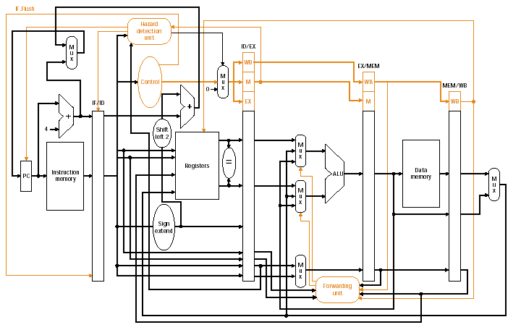
Decide Branch Earlier
IF.Flush
Pipeline Hazards

Slide 40
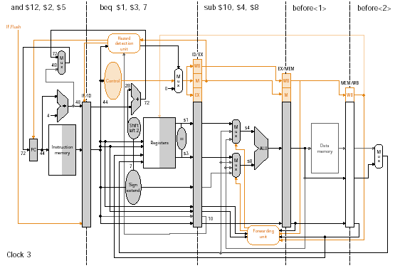
Pipelined Branch – An Example
44:
40:
36:
28
44
72
$4
$8
10
IF.Flush
Pipeline Hazards

Slide 41
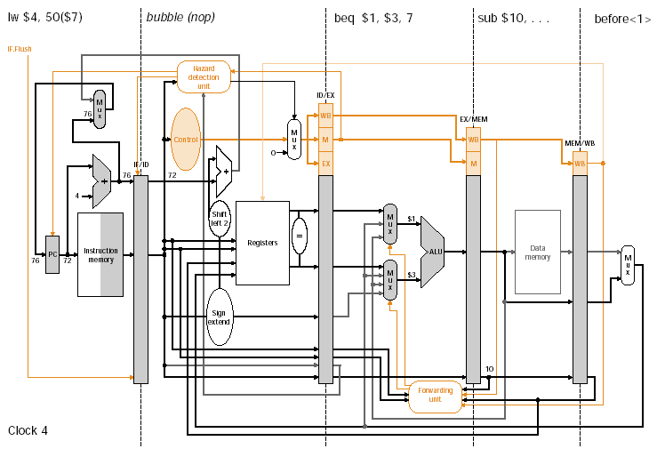
Pipelined Branch – An Example
72:
CS465
Pipeline Hazards

Slide 42
Observations
Basic implementation
  Branch decision does not occur until MEM stage
  3 CCs are wasted
How to decide branch earlier and reduce delay
  In EX stage - two CCs branch delay
  In ID stage - one CC branch delay
  How?
    For beq $x, $y, label, $x xor $y then or all bits, much faster than ALU operation
    Also we have a separate ALU to compute branch address
    May need additional forwarding and suffer from data hazards
3 strategies to further improve
  Branch delay slot; static branch prediction; dynamic branch prediction
Pipeline Hazards

Slide 43
Branch Delay Slot
Will always execute the instruction scheduled for the branch delay slot
  Normally only one instruction in the slot
  Executed no matter the branch is taken or not
Done by compiler or assembler
  Need to be able to identify an independent instruction and schedule it after the branch
Losing popularity
  Why?
    More pipeline stages
    Issue more instructions per cycle
Pipeline Hazards

Slide 44
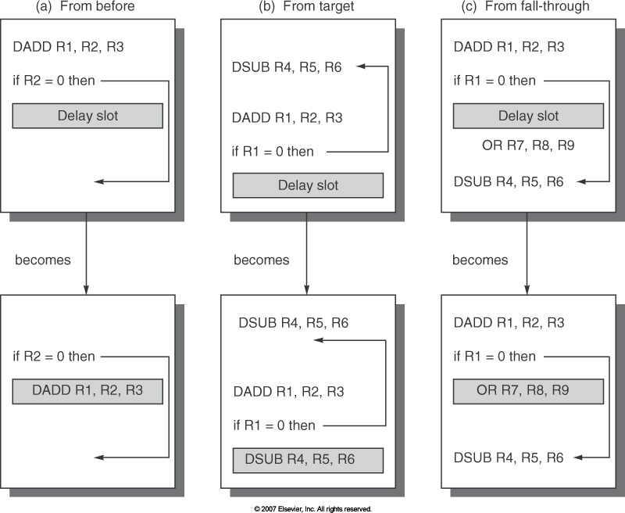
Scheduling the Branch Delay Slot
Independent instruction, best choice
Choice b is good when branch taking probability is high
It must be OK to execute the sub instruction when
the branch goes to the unexpected direction
Pipeline Hazards

Slide 45
Static Branch Prediction
Predict a branch as taken or not-taken
Predict not-taken continues sequential fetching and execution: simplest
  If prediction is wrong, clear the effect of sequential instruction execution
  How to discard instructions in the pipeline?
    Branch decision is made at ID stage: only need to flush IF/ID pipeline register!
Problem: different branch/program vary a lot
  Misprediction ranges from 9% to 59% for SPEC
Pipeline Hazards

Slide 46
Dynamic Branch Prediction
Static branch prediction is crude!
Take history into consideration
  If a branch was taken last time, then fetching the new instruction from the same place
  Branch history table / branch prediction buffer
    One entry for each branch, containing a bit (or bits) which tells whether the branch was recently taken or not
    Indexed by the lower bits of the branch instruction
    Table lookup might occur in stage IF
    How many bits for each table entry?
    Is the prediction correct?
Pipeline Hazards

Slide 47
Dynamic Branch Prediction
Simplest approach: 1-bit prediction
  Use 1 bit for each BHT entry
    Record whether or not branch taken last time
    Always predict branch will behave the same as last time
  Problem: even if a branch is almost always taken, we will likely predict incorrectly twice
    Consider a loop: T, T, …, T, NT, T, T, …
    Mis-prediction will cause the single prediction bit flipped
Pipeline Hazards
Notes:
in a loop, 1-bit BHT will cause two mispredictions (avg is 9 iteratios before exit):
End of loop case, when it exits instead of looping as before
First time through loop on next time through code, when it predicts exit instead of looping

Slide 48
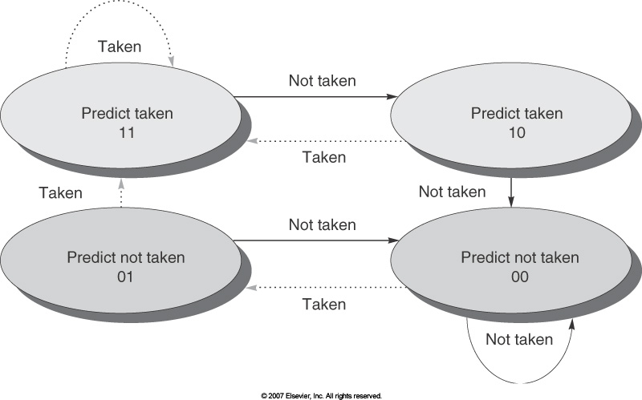
Dynamic Branch Prediction
2-bit saturating counter:
  A prediction must miss twice before changed
  FSA: 0-not taken, 1-taken
  Improved noise
  tolerance
N-bit saturating counter
  Predict taken if counter value > 2^{n-1}
  2-bit counter gets most of the benefit
Pipeline Hazards
Notes:
FSA

Slide 49
In-Class Exercise
Consider a loop branch that is taken nine times in a row, then is not taken once. What is the prediction accuracy for this branch?
  Assuming we initialize to predict taken
  1-bit prediction?
  With 2-bit prediction?
taken
Not taken
Prediction Taken
Prediction Taken
taken
taken
Not taken
taken
Prediction not Taken
Prediction not Taken
Not taken
Not taken
Pipeline Hazards

Slide 50
Hazards and Performance
Ideal pipelined performance: CPI_{ideal}=1
Hazards introduce additional stalls
  CPI_{pipelined}=CPI_{ideal}+Average stall cycles per instruction
Example
  Half of the load followed immediately by an instruction that uses the result
  Branch delay on misprediciton is 1 cycle and 1/4 of the branches are mispredicted
  Jumps always pay 1 cycle of delay
  Instruction mix:
    load 25%, store 10%, branches 11%, jumps 2%, ALU 52%
  What is the average CPI?
Pipeline Hazards

Slide 51
Hazards and Performance
Example (CPI_{ideal}=1)
  CPI_{pipelined}=CPI_{ideal}+Average stall cycles per inst
  Half of the load followed immediately by an instruction that uses the result
  Branch delay on misprediciton is 1 cycle and 1/4 of the branches are mispredicted
  Jumps always pay 1 cycle of delay
  Instruction mix:
    load 25%, store 10%, branches 11%, jumps 2%, ALU 52%
  Average CPI=1.5×25%+1×10%+1.25×11%+2×2%+1×52% = 1.17
⇒CPI_{load} = 1.5
⇒CPI_{branch} = 1.25
⇒CPI_{jump} = 2
Pipeline Hazards

Slide 52
Exceptions
Exceptions: events other than branch or jump that change the normal flow of instruction
  Arithmetic overflow, undefined instruction, etc
  Internal of the processor
  Interrupts from external – IO interrupts
Use arithmetic overflow as an example
  When an overflow is detected, we need to transfer control to the exception handling routine immediately because we do not want this invalid value to contaminate other registers or memory locations
  Similar idea as branch hazard
  Detected in the EX stage
  De-assert all control signals in EX and ID stages, flush IF/ID
Pipeline Hazards
Notes:
at location 0x 8000 0180

Slide 53
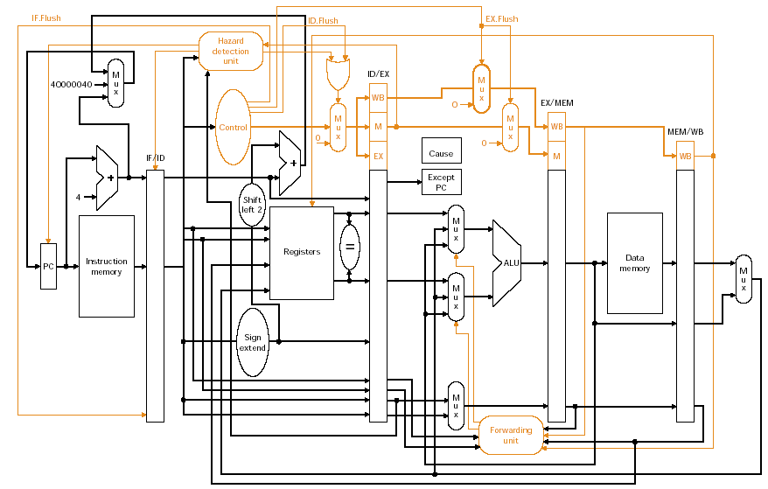
Exceptions
Fig. 6.42
Pipeline Hazards

Slide 54
Example
sub $11, $2, $4
and $12, $2, $5
or $13, $2, $6
add $1, $2, $1 -- overflow occurs
slt $15, $6, $7
lw $16, 50($7)
Exceptions handling routine:
40000040hex sw $25, 1000($0)
40000044hex sw $26, 1004($0)
Pipeline Hazards
Notes:
($26, $27 are k1 and k2 for kernel)

Slide 55
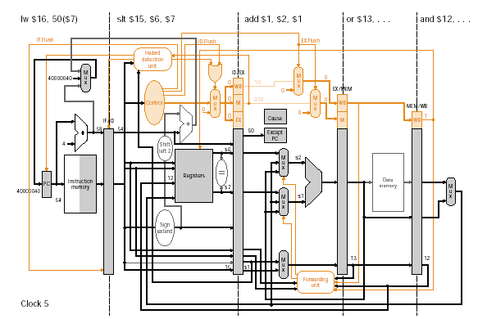
Example
Pipeline Hazards

Slide 56
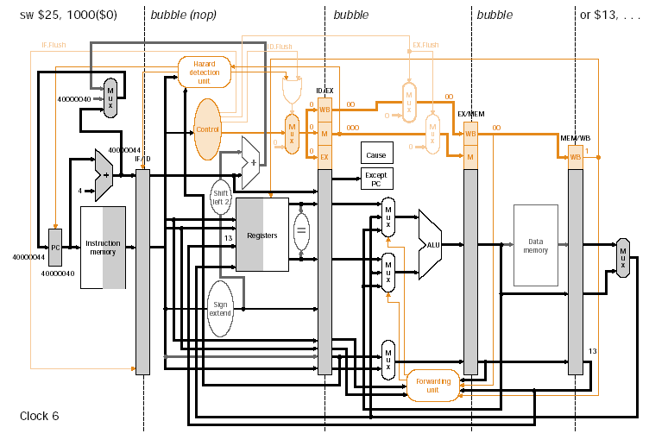
Example
Pipeline Hazards

Slide 57
Summary
Pipeline hazards detection and resolving
  Data hazards
    Forwarding
    Detection and stall
  Control hazards
    Branch delay slot
    Static branch prediction
    Dynamic branch prediction
Exception
  Detection and handling
Pipeline Hazards

Slide 58
Next Lecture
Topic:
  Memory hierarchy
Reading
  Patterson & Hennessy Ch7
Pipeline Hazards

